Slide 1
Advance Streetlight System using IoT

Slide 2
INTRODUCTION
Street Light necessity and importance.
Different types of street lights used.
Working of current system.
Overview of Proposed system.

Slide 3
LITERATURE SURVEY
Title | Authors | Description
Review on Intelligent Street Lightening System | Kavita A. Bajaj, Tushar S. Mote | Proposed a centralized street light system which are switched ON/OFF automatically with the help of LDR status and the value of the PIR sensor, based on solar system.
Automatic Street Lights | Aman Singhal | Proposed a system in which PIR sensor detects any movements the intensity of the lights is maximized and once the vehicle moves ahead of that region the lights automatically go back to the dim mode, hence reduced power consumption.

Slide 4
LITERATURE SURVEY
Title | Authors | Description
A Survey on Automatic Street Lightning System on Indian Streets Using Arduino | Amul Shravankumar Jalan | Proposed a street light system which are switched ON/OFF automatically, using ARDUINO UNO R3, LDRs, LEDs.
Smart street light system with energy saving function based on the sensor network. | Yusaku Fujii, Noriaki Yoshiura, Akihiro Takita, Naoya Ohta | Lights gets completely on and off. There is no automatic controlling of lights, So there is unnecessary wastage of power.

Slide 5
LITERATURE SURVEY
Title | Authors | Description
Movement Sensing Street Lighting (April 18) | Surabhi Gurav, Hardik Rathod, Heta Shah and Nilesh Rathod | Automatic switching of lights,using LDRs,Leds,microcontroller. No system for detection of faulty street lights.

Slide 6
Existing System
Lights gets completely on and off .So there is unnecessary wastage of power.
Conventional street lights uses high intensity discharge lamps (HID).
High carbon emissions, climate changes occur.
No system for detection of faulty street lights.
Existing system requires high maintenance

Slide 7
PROPOSED SYSTEM
The Aim of the proposed system aims at reducing the carbon emission and overall cost by integrating LED’s and wireless communication.
Features of the this system are:
Automatic switching off lights as per requirement.
Automatic fault recognition using sensors.
Intensity control of Streetlights.
Monitoring via wireless communication using built-in Wi-Fi module.

Slide 8
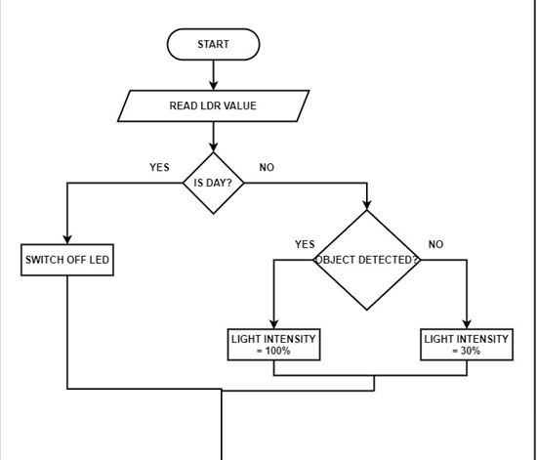
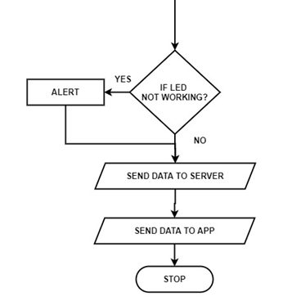

Slide 9
METHODOLOGY
The different components and technologies used in this system are :
NodeMCU
Ultrasonic sensor
Light sensor
LED
IFTTT
ThingSpeak

Slide 10
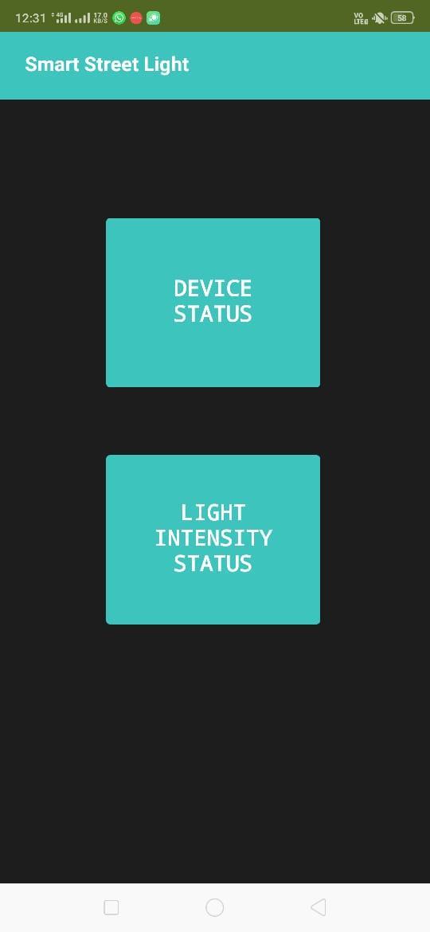
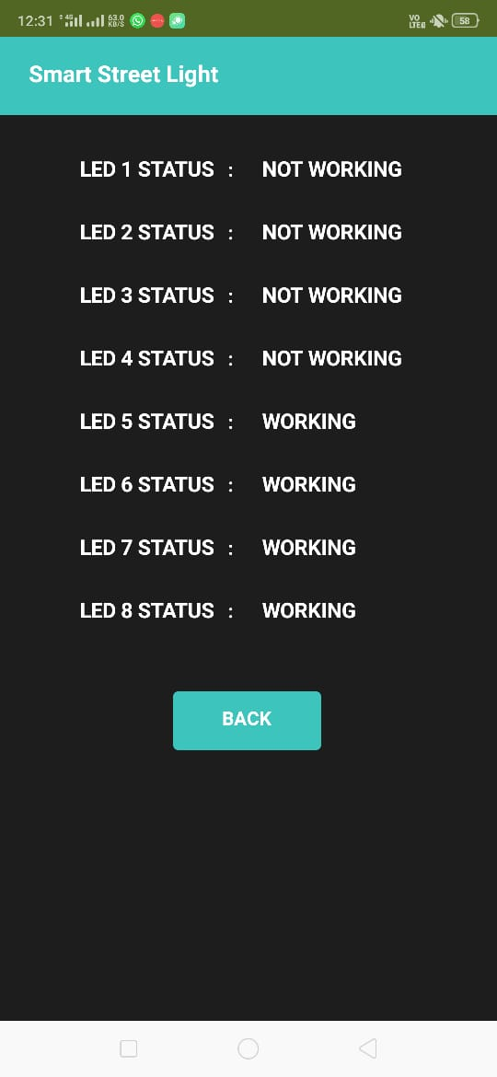
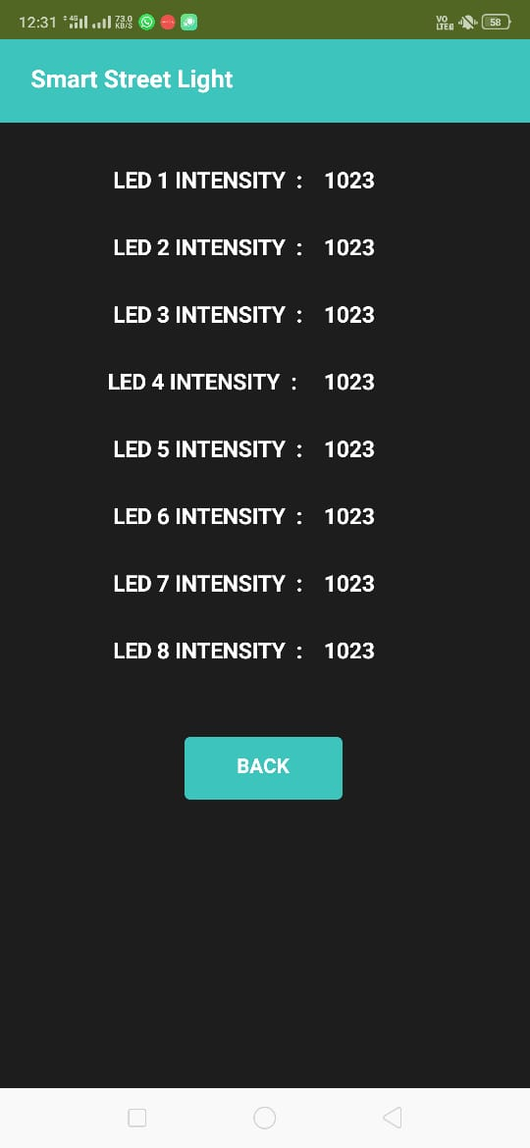
RESULTS
Figure 1
Figure 2
Figure 3

Slide 11
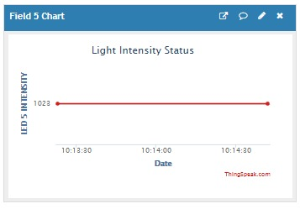
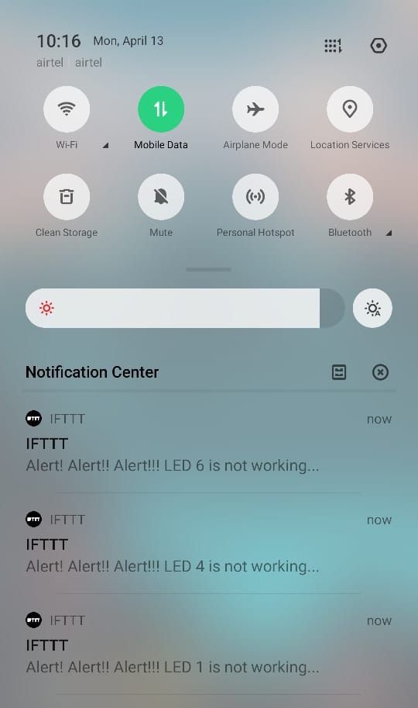
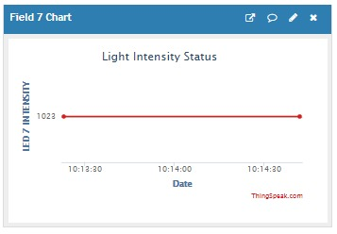
Figure 5
Figure 6
Figure 4

Slide 12
CONCLUSION
The main benefit of our project is power saving.This project incorporates NodeMCU with built-in Wi-Fi module, which is easy to maintain and cost-efficient too. Due to the automatic message sent to the authorities, maintenance becomes easier. The system is versatile and adjustable according to the needs of the user.

